Slide 1
Fall 2015 edition Policy Ignite Blockchain
Opening

Slide 2
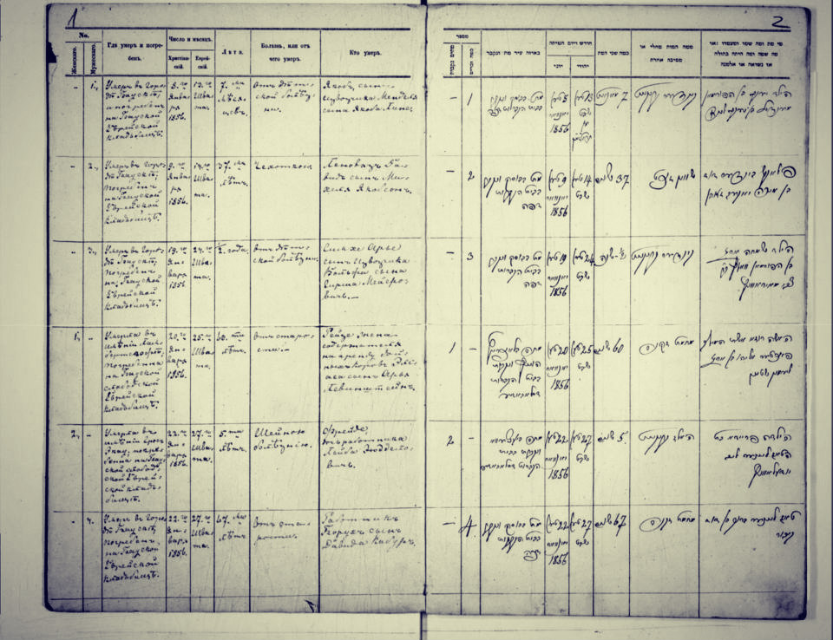

Slide 4
Benefits
Create new markets
Build trust
Increase cost-effectiveness
Establish faster & more convenient systems
Heighten transactional security






Slide 5
Open Government Fit
INNOVATIVE
TRANSPARENT
ACCOUNTABLE
EFFICIENT
OPEN GOVERNMENT PRINCIPLES

Slide 6
International Response
United Kingdom

Slide 7
United Kingdom

Slide 8
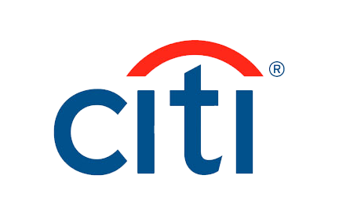
International Response

Slide 9
Domestic Response
Canada

Slide 11
Potential Uses
Asset registry
Hard assets


Inventory & exchange
Intangible assets
⬧


Slide 12
Potential uses

Judiciary
Government

Health
Science

& …


Slide 18
Intellectual Property Rights
Trademarks

Patents
Industrial Designs



Slide 19
How to Scale
83 %
93%
75 %
104%
63 %
50%
30 %
40 %
2013
2014
2015
2016
2017
2018
2019
2020

Slide 20
Closing
danutfm@gmail.com
Twitter: @danutfm

